Slide 1




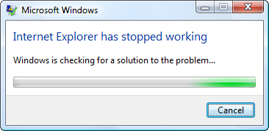

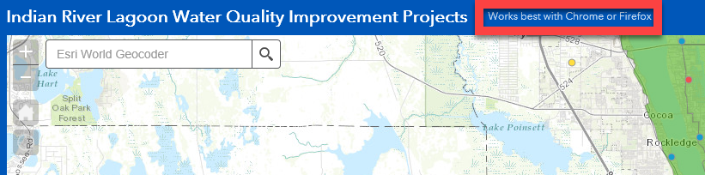
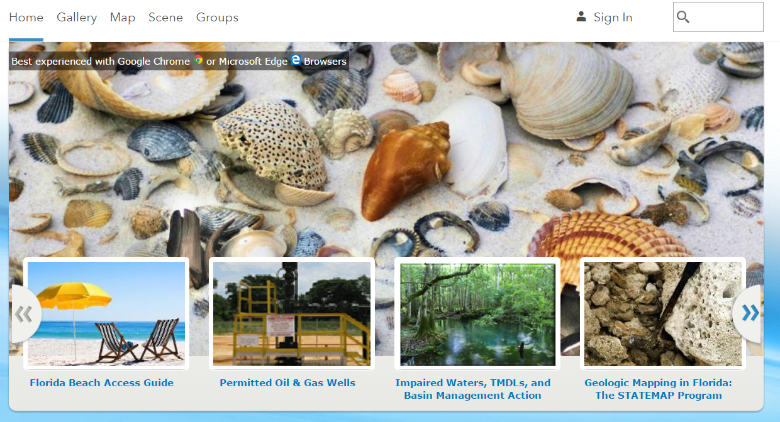
GET THE RIGHT BROWSER FOR GIS CONTENT
THE ISSUE
Edge
TAKE ACTION
Some GIS content is scrambled or times-out before loading.
Browser technology has changed dramatically over the past year. The new generation of browsers address standards compliance and are highly performance driven to leverage the new graphics and processing required by GIS and similar web apps.
Microsoft is no longer updating Internet Explorer, apart from security patches. As a result, performance and compatibility with current web standards will continue to sharply decline over the next few years. This makes it unsuitable for GIS web mapping applications, which demand a great deal from the browser.
Internet Explorer is only retained by Microsoft in order to support legacy web pages that use proprietary features which are no longer supported in modern browsers. DEP uses several legacy applications, including People First, that require IE, so it will stay on your computer. –April 2017
Contact Kimberly Jackson Kimberly.d.Jackson@dep.state.fl.us for more info.
RECENT E-MAIL FROM A DEP GIS USER:
“I switched to Edge and saw a noticeable change in search speeds. It took about 3 seconds to find an address whereas before it would take several minutes or just freeze. I think this might have been the problem. Thanks for your help! “
-Greg
1. Submit a service desk ticket to have Google Chrome browser installed if you do not already have EDGE on your PC and alternate devices like tablets and laptops.
2. Outreach to your stakeholders and recommend that they have an alternate browser available to view your GIS content.
3. Check that presentation setups at public meetings, the legislature or other agencies include a computer with the Google Chrome or Edge browser.
4. Consider adding notes that tout the benefits of updated browsers, to your web pages and content, that promotes GIS products.
Current IE Limitations for GIS
Map Direct users in District Offices report long (4-5 minute) lags for result returns or frequent crashing when using IE.
You cannot view streaming feature layers in the map viewer.
Within the My Organization > Open Data page, the Your Open Data Sites list does not appear.
You cannot open metadata XML files or save local copies of your current metadata document in the built-in metadata editor.
You cannot add CSV items (in My Content) as web layers in the map.
You cannot use the scene viewer or open apps created from scenes. If the map contains feature layers, labels on the following base maps may appear hidden: Imagery with Labels, Dark Gray Canvas, Light Gray Canvas, World Oceans, and Terrain with Labels.

