Slide 1
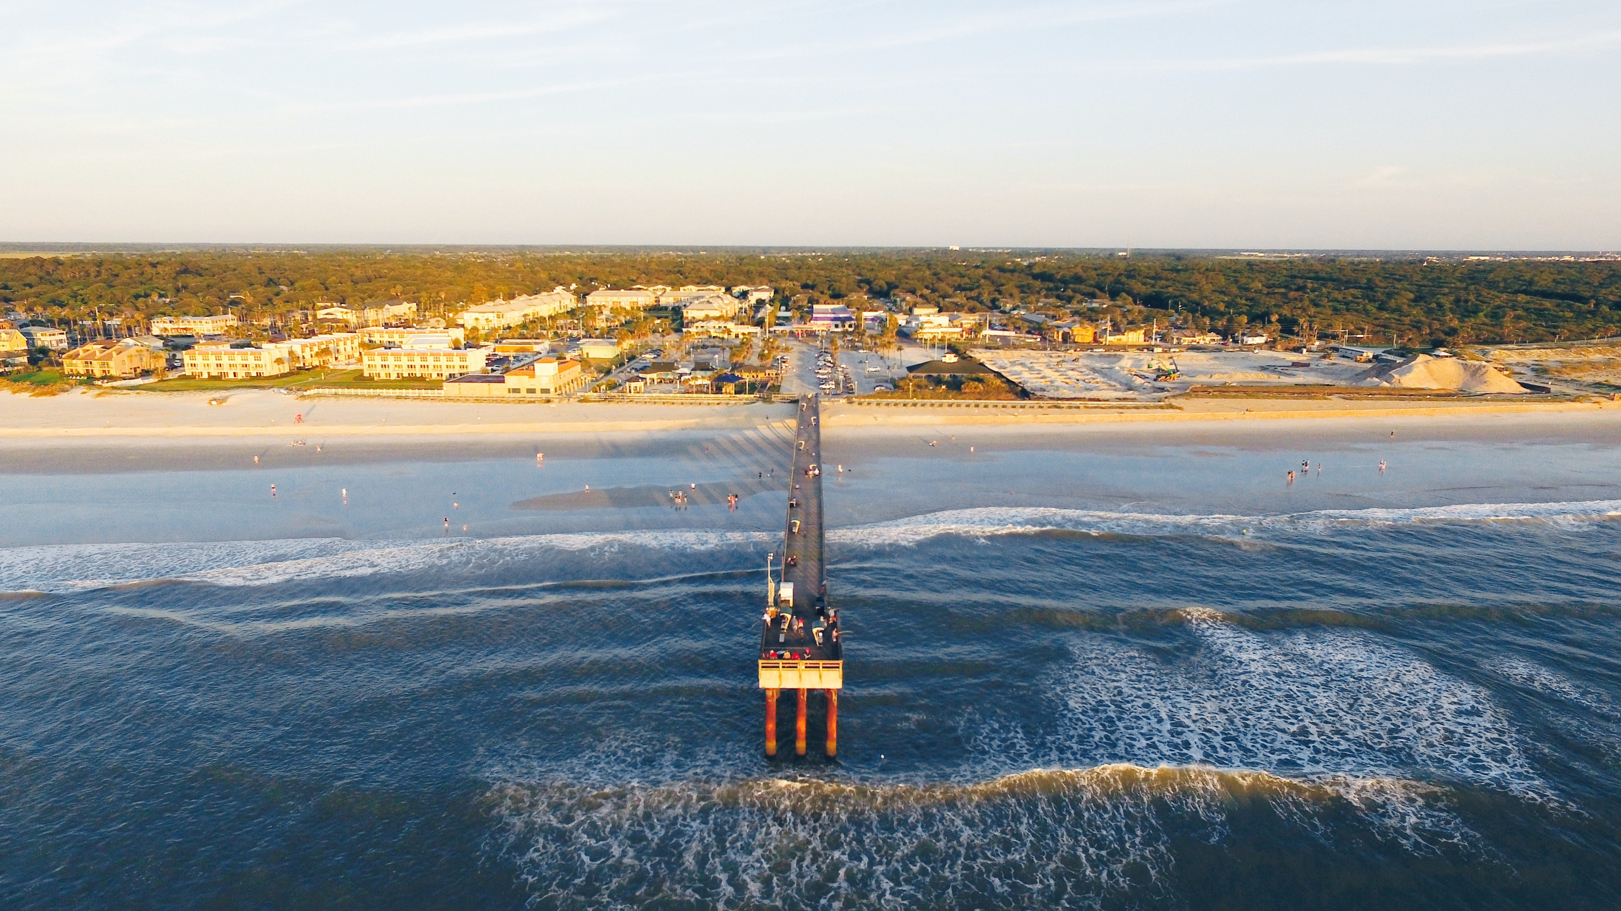
December 2017 GIS Coordination NOTES
Due to the difficulty of scheduling all interested GIS staff at one meeting during this Holiday month, this presentation will serve as our winter meeting. There will be an in person meeting (with Skype for those outside Tallahassee) scheduled for Summer 2018.
The GIS team can be reached at GIS.Librarian@dep.state.fl.us anytime.

Slide 2
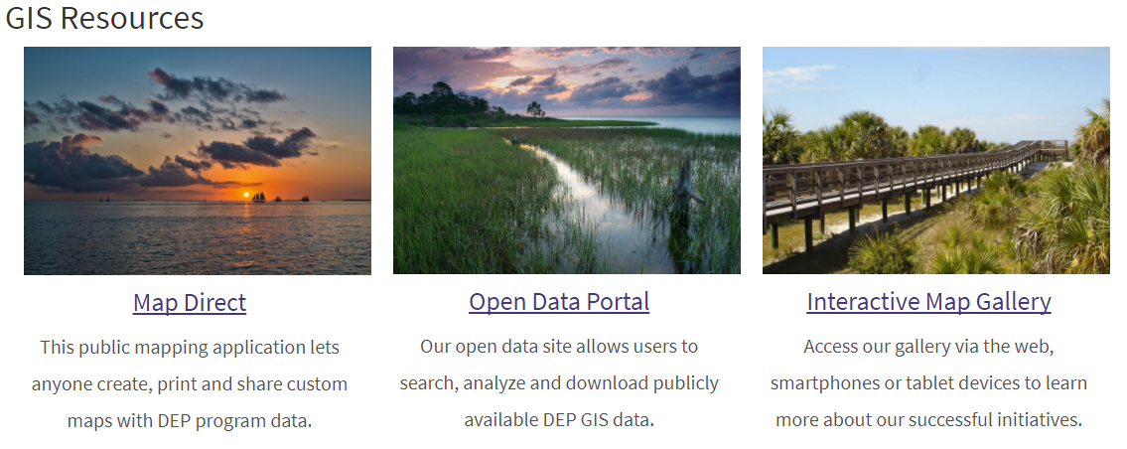
New GIS Internet web page https://floridadep.gov/otis/enterprise-application-services/gis

Slide 3



Last month we completed our GIS Infrastructure Migration to the Azure Cloud
for ArcGIS Server and the enterprise geospatial data library
This migration to Azure:
Addressed need for additional
hardware resources
Provides flexibility in times of high usage
Allows for testing and patching without
impacting production
Improved disaster response & recovery
Is cost effective!
Went Live:
11/29/17
Testing
since July
Virtual server at
Southwood Data Center
Virtual server in
in the Microsoft
Azure Cloud

Slide 4

November 29th , OTIS hosted a GIS Disaster Response Workshop
at the Dept. of Emergency Management’s Emergency Operations Center
The workshop presentation
is on SharePoint

Slide 5
RECENT National AWARDS
Thanks to everyone involved in Hurricane Irma Response
Thanks to everyone who contributed to the AST GIS Workgroup
Catalyst: Florida SERT GIS
State agency, regional agency, and county GIS managers, analysts, and technicians came together as the SERT GIS to support the Florida State Emergency Response Team during Hurricane Irma. Under the leadership of Florida Division of Emergency Management GIS Administrator Jason Ray, the team participated on daily GIS coordination calls, coordinating post-disaster remote sensing coordination requirements, sharing data and resources, and improved outcomes during Hurricane Irma preparedness, response, and recovery.
Champion: Florida AST Enterprise GIS Workgroup, co-chairs Richard Butgereit and Kim Jackson
When the Agency for State Technology strategic planning group surveyed state agencies to find "golden threads" for opportunities for improvements in state government, statewide GIS coordination was identified as just such an opportunity. After being assigned the task, Strategic Planning Coordinators Kayren McIntyre and Eric Steinkuehler threw themselves into the effort of convening and sustaining an enterprise GIS workgroup. After two years under their leadership and championship, the workgroup made significant progress creating a statewide GIS open data portal, the state's first GIS resources and information page, and presented a business case and justification, which has lead to the creation of a geographic information office within the Agency for State Technology.

Slide 6
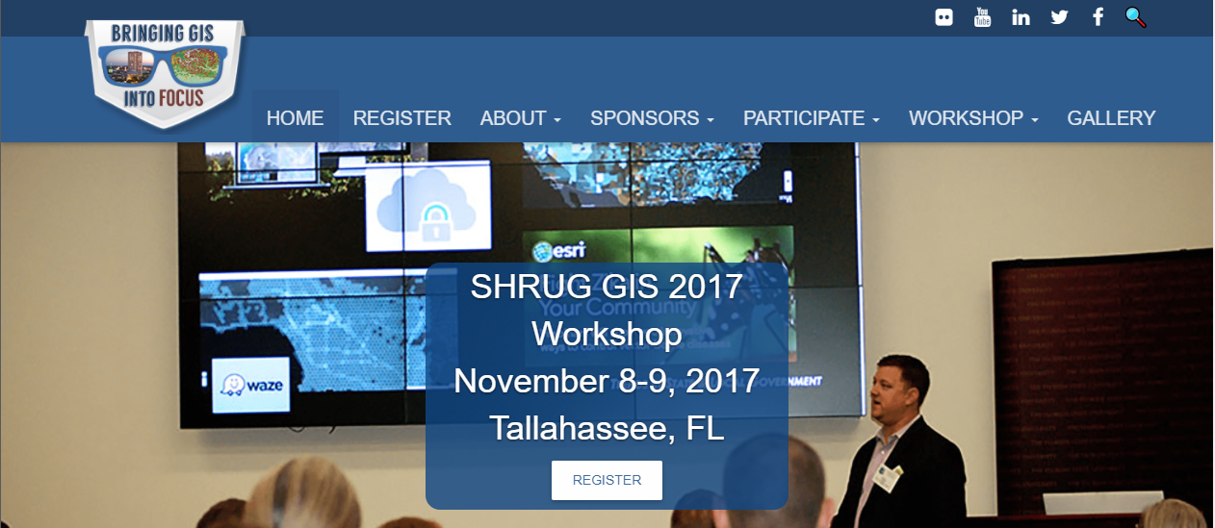
SHRUG WORKSHOP 2017
Thank you to the DEP presenters and those that attended. If you are interested in attending the November 2018 event, please contact your GIS Coordinator to have your request reviewed on the Spring 2018 training plan for FY 2018-19

Slide 7

Please review and Share the latest GIS Welcome packet and join the GIS_L list serve for GIS news and updates

Slide 8

Migration away from ArcGIS Desktop software by December 2020- the 3 year plan
Which GIS should current desktop users, use?
Let’s ask a different question…
Ask: What work do people need GIS to accomplish?

Slide 9
DEP Enterprise GIS OPTIONS 2017
500,000 uses per year
15 million +
including parks web maps
MapDirect
ArcGIS PRO
ArcGIS Desktop
ArcGIS Online
60 Named Users
576 Approved Users
277 Named Users
Free web based GIS with all DEP data and other agency GIS provider data available. Map, report, and share.
Easy to learn.
High end GIS analysis and modelling tool. Remote login.
Cost allocated.
Steep learning curve.
Old school desktop software. Limited modelling & mapping capabilities.
Steep learning curve.
Being discontinued by ESRI.
Online GIS platform for mapping, analysis, app creation, story maps and mobile data collection and emergency response.
Easy to learn.

Slide 10
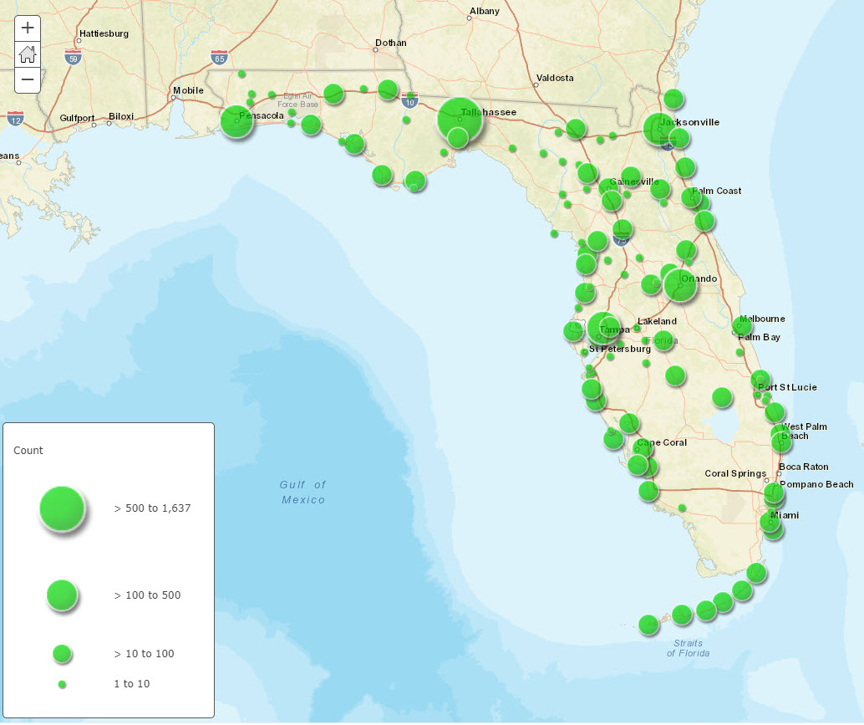
Implementing a plan to
migrate out of
Desktop GIS
(per ESRI guidance)
And use other
enterprise GIS resources
to support staff statewide
January GIS User
Needs Assessment
Share with Program Area Coordinators at December meeting
(see slide 12)
DEP Staff

Slide 11
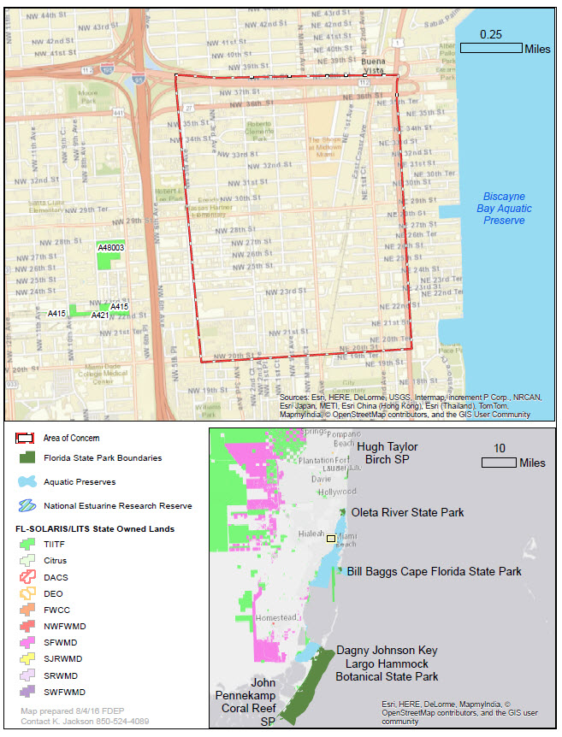

ArcGIS DESKTOP
Not available or in use at DEP after December 31, 2020.
(3 year migration)
Starting now (January 1, 2018):
All new staff requesting GIS software will be trained on AGO, Map Direct and/or PRO, not desktop.

Slide 12
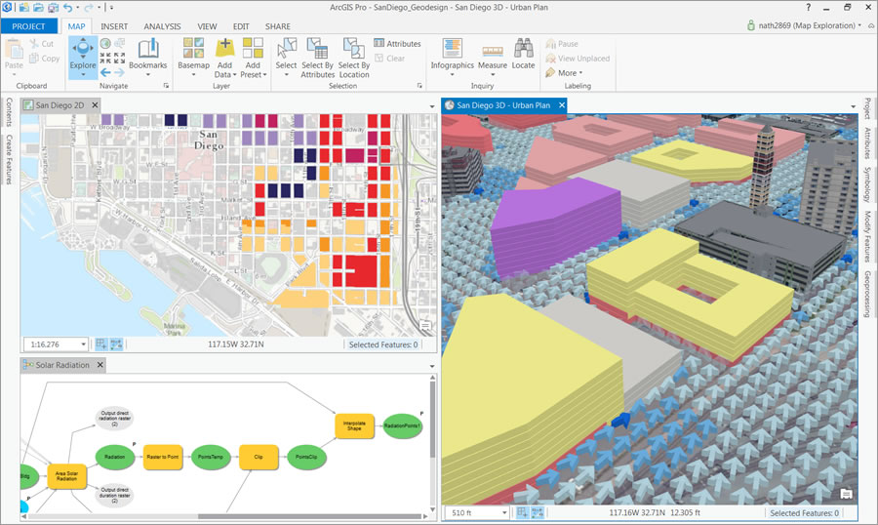

ArcGIS PRO
Desktop software, requires high end PC
Free, in-house training available.
Steep learning curve!
PRO is for editors and data stewards
PRO is for 3D visualization
PRO is for programmers and modelers

Slide 13

ArcGIS Desktop Migration Planning First meeting in December 2017
GIS Coordinators ONLY: Please sign up ASAP
When A SKYPE meeting time is scheduled, it will disappear from the list.
Others may attend but we are asking only the GIS Coordinator to schedule the meeting to avoid double or triple bookings. Thank you.
AGENDA
1. Verify your Program / District’s IT coordinator and GIS Coordinator (OTIS)
2. Verify list of current approved ArcGIS Desktop users and ArcGIS PRO users (OTIS)
3. Verify inventory of current enterprise GIS data in the DEP library and verify stewardship information for each layer (OTIS)
4. Verify inventory of Map Direct embedded maps and custom focuses for your program area / district (OTIS)
5. Create and review a list of workflows and business procedures that use ArcGIS Desktop (Program area)
6. Approve a plan to provide new users, GIS software, after December 31st, 2017
Schedule next meeting

